Slide 1







Final Project in
C++
Presentation

Slide 2


Group Student ID
5011
4775
5113
5050
4976
4894
5299
4819
4859
5354

Slide 3
A credit card validator : is a tool or algorithm used to verify whether a given credit card number is valid or not according to certain rules.

Slide 4
Types of Credit Card validator
Luhn Algorithm:The Luhn algorithm is a widely used method for validating credit card numbers.
Issuer Identification Number (IIN) Validation:Each credit card issuer has a unique Issuer Identification Number (also known as the Bank Identification Number or BIN) that forms the first few digits of the credit card number
Valid Card Number Ranges:Some credit card issuers have specific ranges of valid card numbers.
Additional Validation Rules:Some credit cards might have additional rules specific to the issuer.
Format Validation:Credit card numbers have specific lengths and formats depending on the issuer

Slide 5
What We used for This Project.
Code Over View

Slide 6
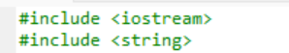
Code Over View.
Iostream:Input-output stream header file for handling input and output operations.
string: Data type to store strings

Slide 7
Code Over View.
Bool: A data type representing a Boolean value either true or False. Functions with return type of bool return true or false based on certain condition.
for loop: Used for iteration over elements in an array or container.
do/while Loop: same the for loop but the programars choose depending what they use it.
If else : Used for conditional branching.

Slide 8
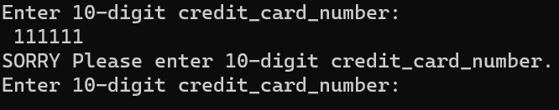
Code Over View.
Function: validate_credit_card(const string& credit_card): A function to check if a credit card number is valid by verifying that it contains only digits and has a minimum length of 10 digits.
Function:validate_credit_card_number(const string& credit_card, const string& valid_credit_cards): A function to validate if the entered credit card number matches any of the predefined valid credit card numbers.

Slide 9
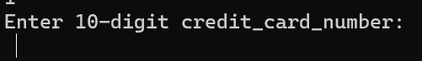
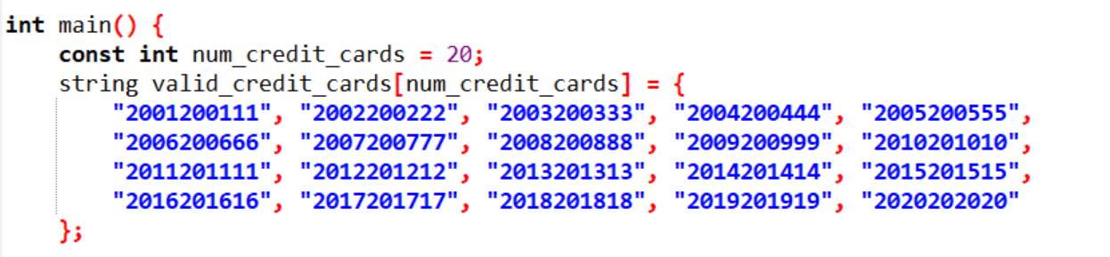
Code Over View.
Function: string enter_credit_card():A function to prompt the user to enter a 10-digit credit card number and validate it.
main function: In the main function an array valid_credit_cards containing 20 valid credit card numbers is declared and initialized.

Slide 10
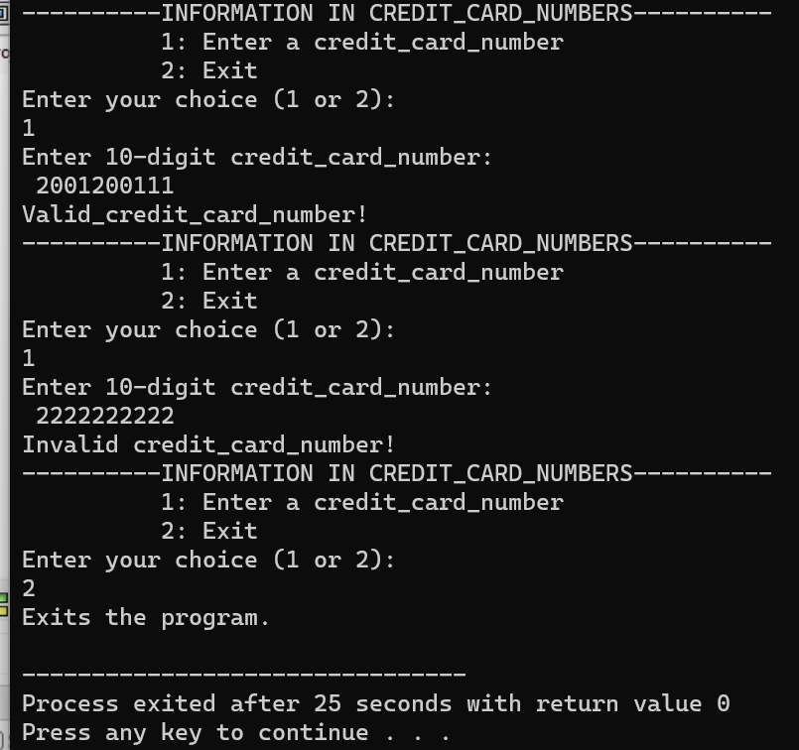
Code Over View.
switch statement: Used for multi-way branching based on the value of an expression.
If else : Used for conditional branching.

Slide 11
Code Over View.
Overall, this code implements a simple credit card validation system where the user can enter a 10-digit credit card number, and the program checks if it matches any of the pre-defined valid credit card numbers. If it does, it is considered valid; otherwise, it is considered invalid. The program continues to prompt the user for input until the user chooses to exit.

Slide 12


THANK YOU

